Slide 1



Community Pharmacy
Hot Topic Report
February 2025

Slide 2


Why we did it
What we did
  We received growing concerns from the public about pharmacy access and medicine shortages
  Mixed reviews about the new Pharmacy First Scheme which has the potential to enhance access to primary care
  Community pharmacies are a cornerstone of primary care, serving as accessible, walk-in healthcare providers for local communities.
  Designed a Hot Topic Survey
  Explored public experiences with community pharmacies, focusing on accessibility, medicine shortages, reasonable adjustments for dispensing needs
  Examined perceptions of Pharmacy First scheme & aimed to raise awareness of this new initiative
  Asked both quantitative & qualitative questions
  Collected 284 responses & analysed the data
Community Pharmacy Hot Topic Report, February 2025

Slide 3
Accessibility
Community Pharmacy Hot Topic Report, February 2025

Slide 4

97.5% (277) respondents used a pharmacy
in the last 12 months
Source: All respondents (n=284)
Community Pharmacy Hot Topic Report, February 2025

Slide 5
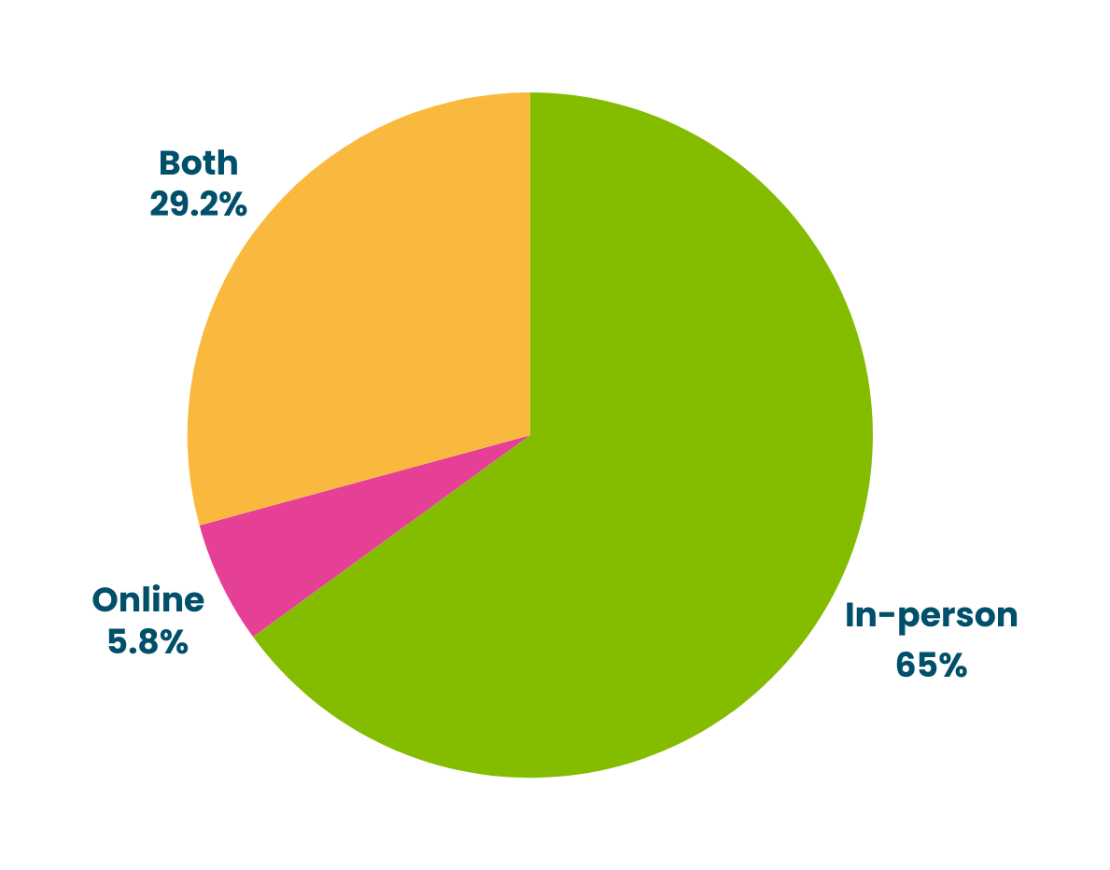



(81)
(16)
(180)
How people prefer to access their pharmacy?
Source: Respondents who used a pharmacy in last 12 months (n=277)
Community Pharmacy Hot Topic Report, February 2025

Slide 6
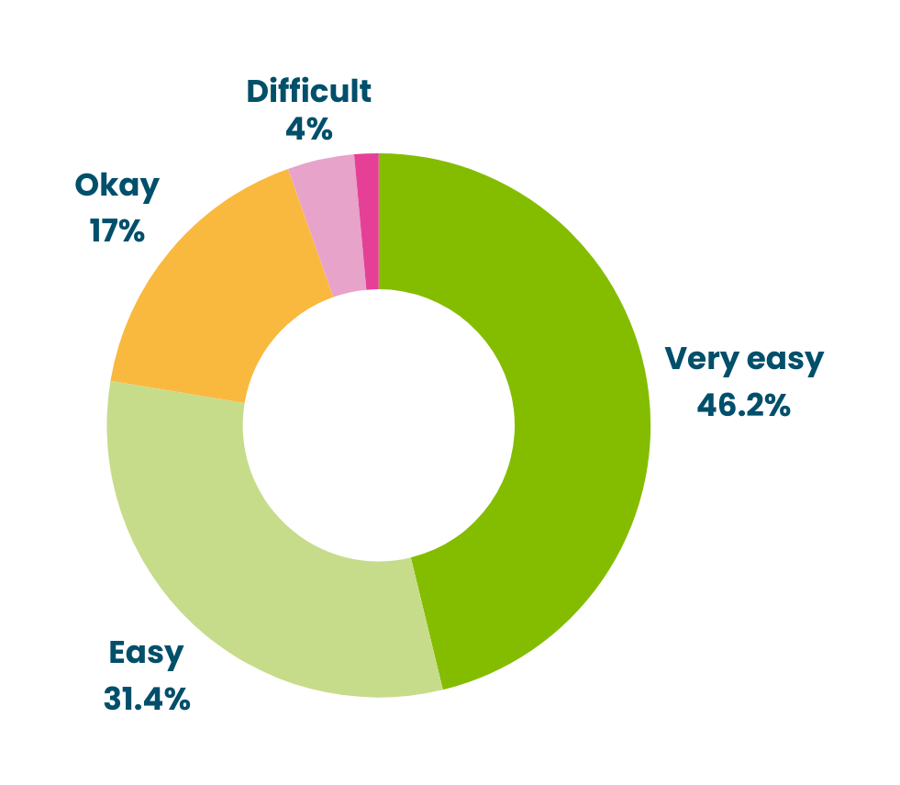




Very Difficult
1.4%
(11)
(4)
3 in 4 people
find accessing their pharmacy easy/very easy
(47)
Source: Respondents who used a pharmacy in last 12 months (n=277)
(128)
(87)
How convenient people find it to access their pharmacy?
Source: Respondents who used a pharmacy in last 12 months (n=277)
Community Pharmacy Hot Topic Report, February 2025

Slide 7
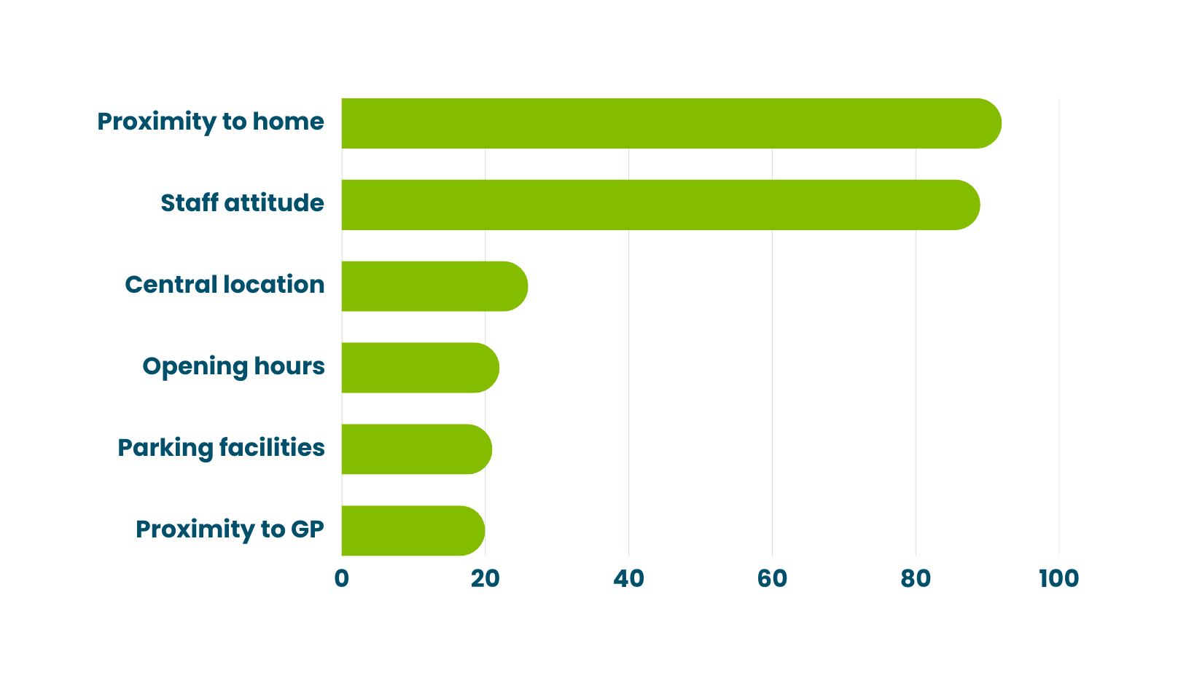
What makes it easy for people to access their pharmacy?
Source: Respondents who used a pharmacy in last 12 months (n=277)
Community Pharmacy Hot Topic Report, February 2025

Slide 8
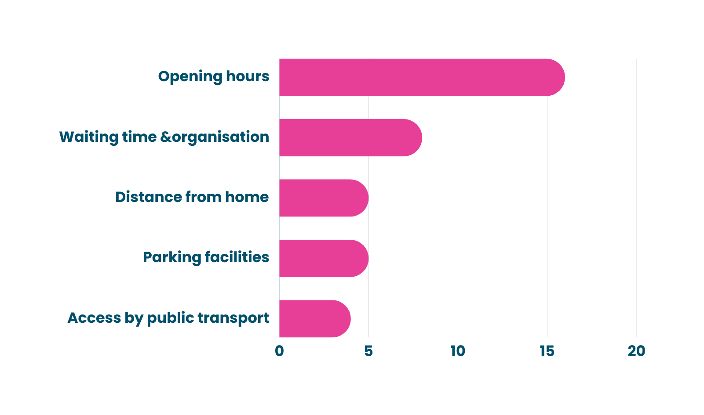
What makes it difficult for people to access their pharmacy?
Source: Respondents who used a pharmacy in last 12 months (n=277)
Community Pharmacy Hot Topic Report, February 2025

Slide 9
Medicine Supply & Shortages
Community Pharmacy Hot Topic Report, February 2025

Slide 10

Almost 2 in 5 people
have faced problems in their medicine supply
Source: Respondents who used a pharmacy in last 12 months (n=277)
Community Pharmacy Hot Topic Report, February 2025

Slide 11
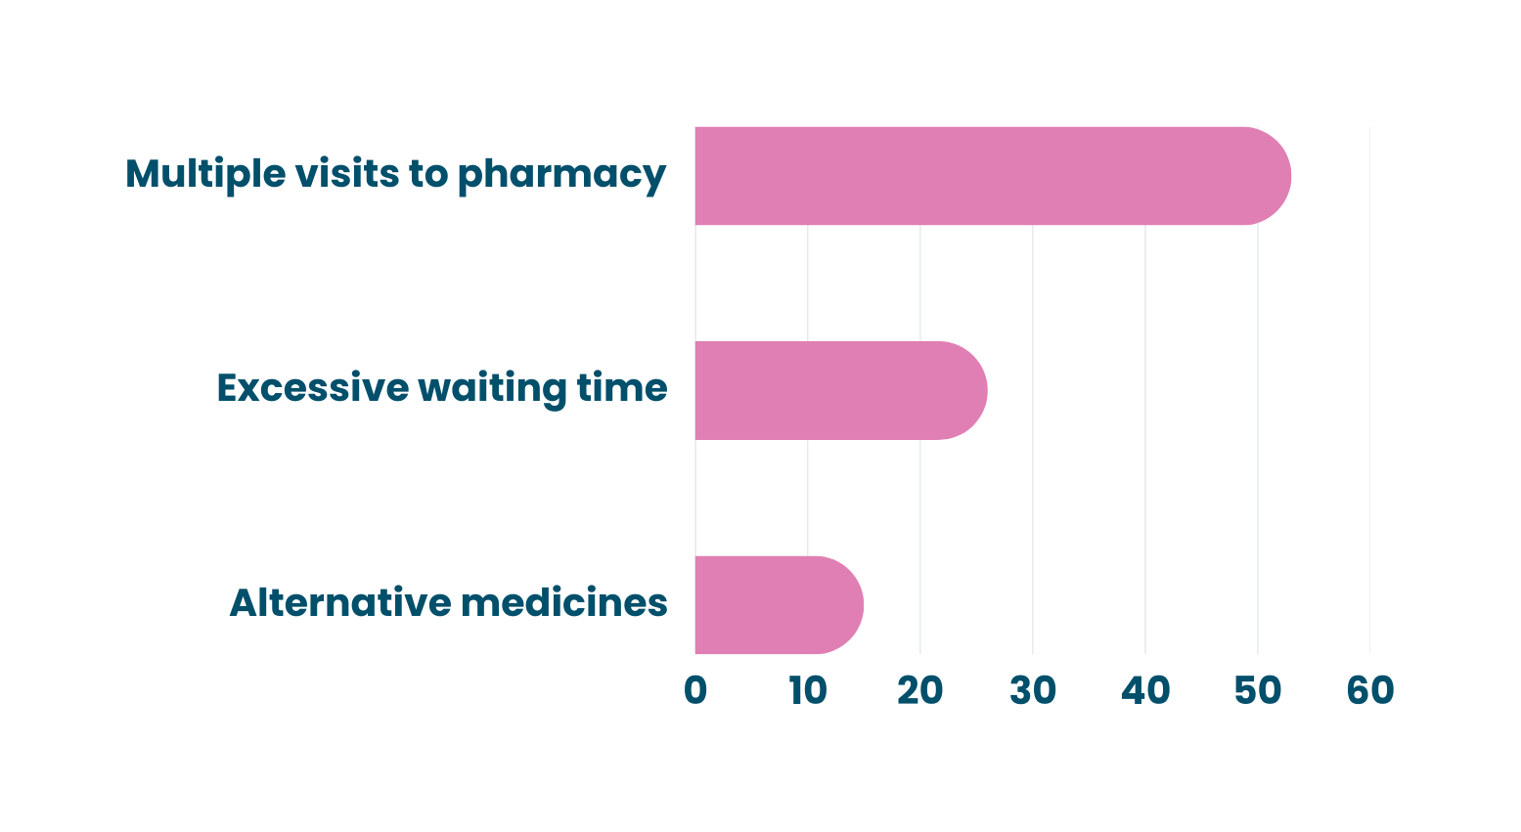
Consequences of medicine shortages for patients
Source: Respondents who used a pharmacy in last 12 months (n=277)
Community Pharmacy Hot Topic Report, February 2025

Slide 12
Reasonable Adjustments for
Medicine Dispensing
Community Pharmacy Hot Topic Report, February 2025

Slide 13
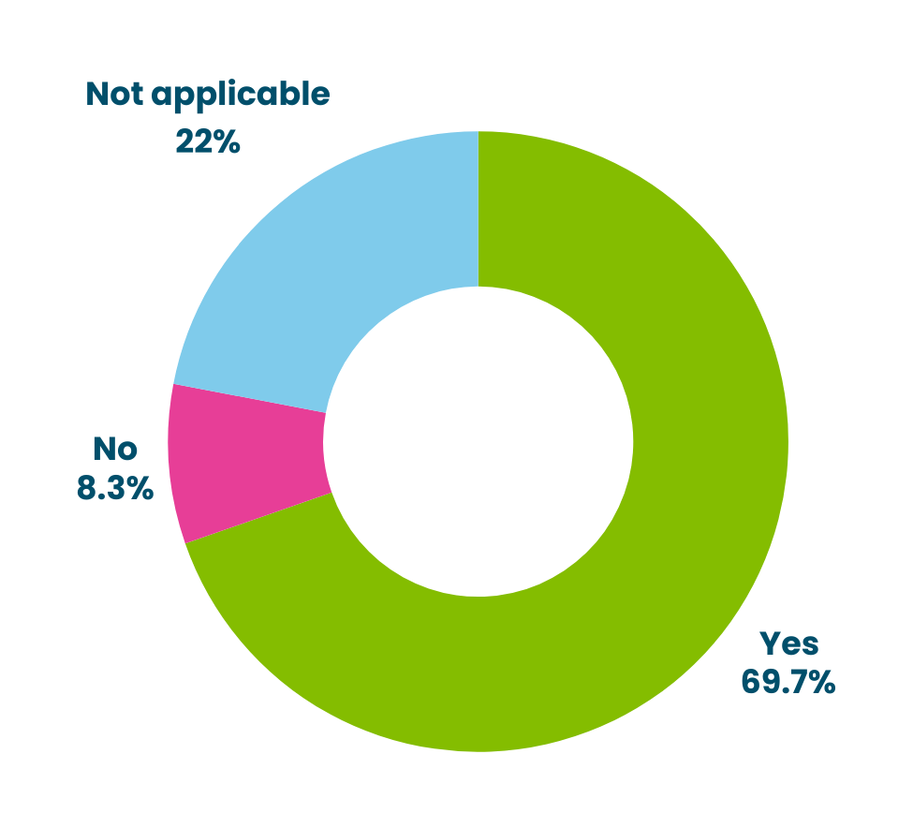



(61)
(23)
(193)
Are medicines dispensed in a way that meets your needs?
Source: Respondents who used a pharmacy in last 12 months (n=277)
Community Pharmacy Hot Topic Report, February 2025

Slide 14


Notable trends
Vulnerable groups are disproportionately impacted by challenges in access, medicine shortages and dispensing tailored to their needs.
These include people living with:
  Mental health conditions
  Physical or mobility impairment
  Sensory impairment
  Long term conditions
  Cared for
  Carers
Community Pharmacy Hot Topic Report, February 2025

Slide 15
Payment for prescriptions
Community Pharmacy Hot Topic Report, February 2025

Slide 16
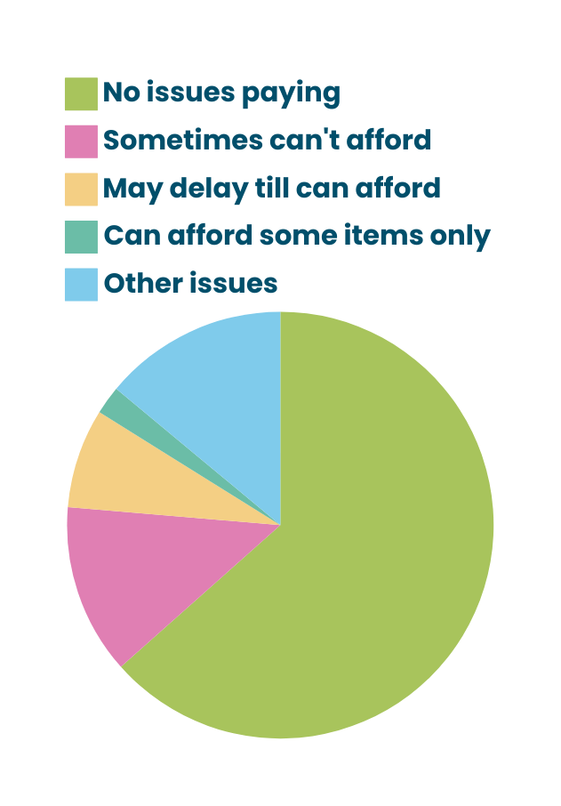




(59)
(12)
(7)
(2)
(13)
Don’t Pay for Prescriptions
69%
(177)
27%
of those who pay for prescriptions reported issues with affordability
Pay for
Prescriptions
31%
(81)
Affordability of Prescriptions
Source: Respondents who answered this question (n=258)
Community Pharmacy Hot Topic Report, February 2025

Slide 17
Pharmacy First
Community Pharmacy Hot Topic Report, February 2025

Slide 18

40% (112) respondents had heard about
Pharmacy First
Source: Respondents who used a pharmacy in last 12 months (n=277)
Community Pharmacy Hot Topic Report, February 2025

Slide 19
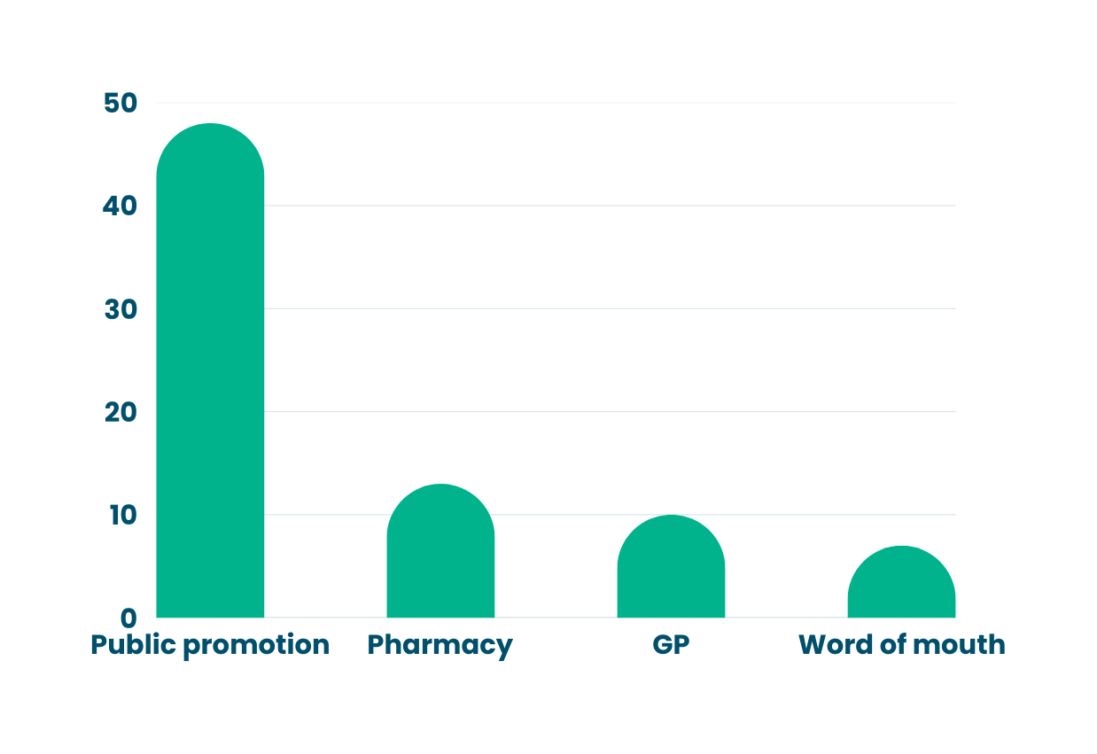







How did people hear about Pharmacy First?
Source: Respondents who used a pharmacy in last 12 months (n=277)
Community Pharmacy Hot Topic Report, February 2025

Slide 20

1 in 4 people
have tried using Pharmacy First
Source: Respondents who used a pharmacy in last 12 months (n=277)
Community Pharmacy Hot Topic Report, February 2025

Slide 21



Mixed feedback about
Pharmacy First
  Provided quick treatment/ advice
  Signposted to GP or other service
  Easy to access
  Saved GP visit
  Increased treatment time due to referrals
  Limitations in age, conditions, or medications covered
  Lack in confidence in pharmacists’ ability to diagnose & prescribe
  Added cost
Gaps in public awareness about the full offer,
Public attitude & perception,
Training need
Community Pharmacy Hot Topic Report, February 2025

Slide 22
Recommendations
Community Pharmacy Hot Topic Report, February 2025

Slide 23


Recommendations
Opening Hours
Ensure good communication between pharmacists and patients, especially around affordability, reasonable adjustments, supporting vulnerable patients.
Proactive approach in communicating with the public about medicine shortages and pharmacy closures by the ICB.
Adjust opening hours to better align with the needs of working individuals.
Improved clarity in communication will enhance the effectiveness and long term sustainability. Focus on eligibility awareness, building public confidence & effective signposting.
The ICB needs to actively monitor and mitigate the effects of closures.
Effective Communication
Pharmacy First Scheme
Communication on Medicine Shortages and Pharmacy Closures
Pharmacy Accessibility & Location
Community Pharmacy Hot Topic Report, February 2025

Slide 24
Thank you!
Community Pharmacy Hot Topic Report, February 2025
Community Pharmacy Hot Topic Report, February 2025

